Slide 1


Getting Started with Raspberry Pi
training program that will help you to set up and run your own Raspberry pi
Brought to you by Robosapiens technology Pvt. Ltd.
Copyright Robosapiens Technology Pvt. Ltd.

Slide 2
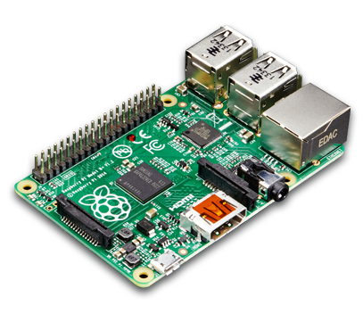



Raspberry Pi
The Raspberry Pi is a series of credit card–sized single-board computers.
It is developed in the United Kingdom by the Raspberry Pi Foundation.
Raspberry Pi is based on the Broadcom BCM2835 system on a chip (SoC).
It includes an ARM1176JZF-S 700 MHz processor, VideoCore IV GPU.
The Raspberry Pi Foundation provides Debian and Arch Linux ARM distributions for download.
Copyright Robosapiens Technology Pvt. Ltd.

Slide 3
Different models of Raspberry Pi
Five Different models of Raspberry Pi are available in the market.
Raspberry Pi model A
Raspberry Pi model A+
Raspberry Pi model B
Raspberry Pi model B+
Raspberry Pi 2 model B
Copyright Robosapiens Technology Pvt. Ltd.

Slide 4
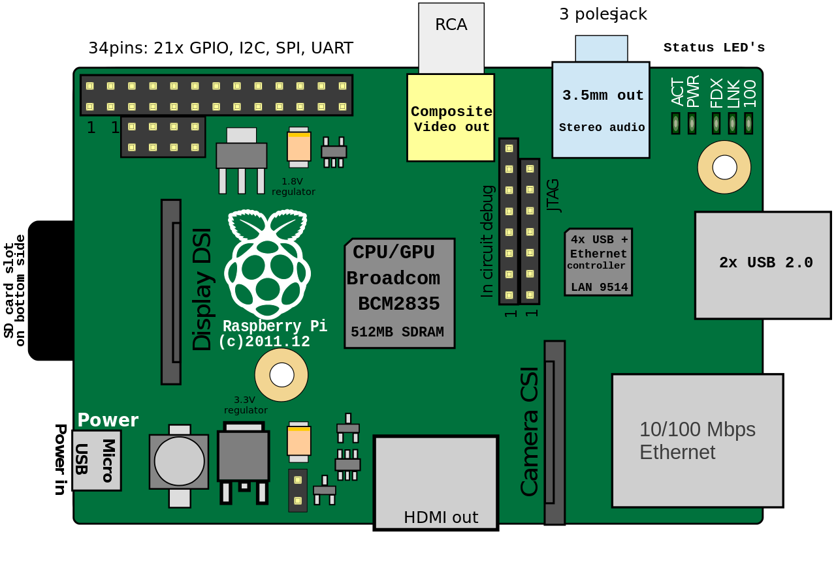
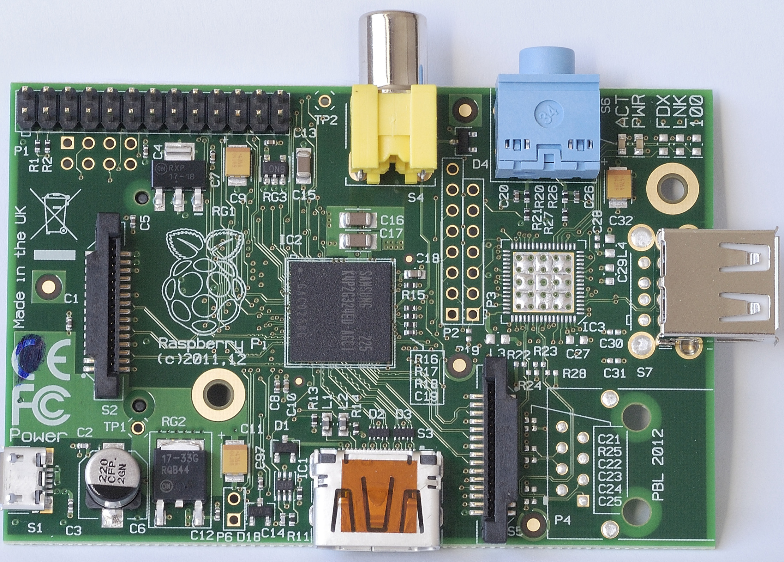
Raspberry Pi Model A
CPU: BCM2835
No. of cores: 1
Operating Frequency: 700 MHz
GPU: Broadcom VideoCore® IV @250Mhz
RAM: 256MB(shared)
Video out: HDMI + RCA
Storage: SD/MMC/SDIO
GPIO: 8 Pins
Power: 300mA
Copyright Robosapiens Technology Pvt. Ltd.

Slide 5
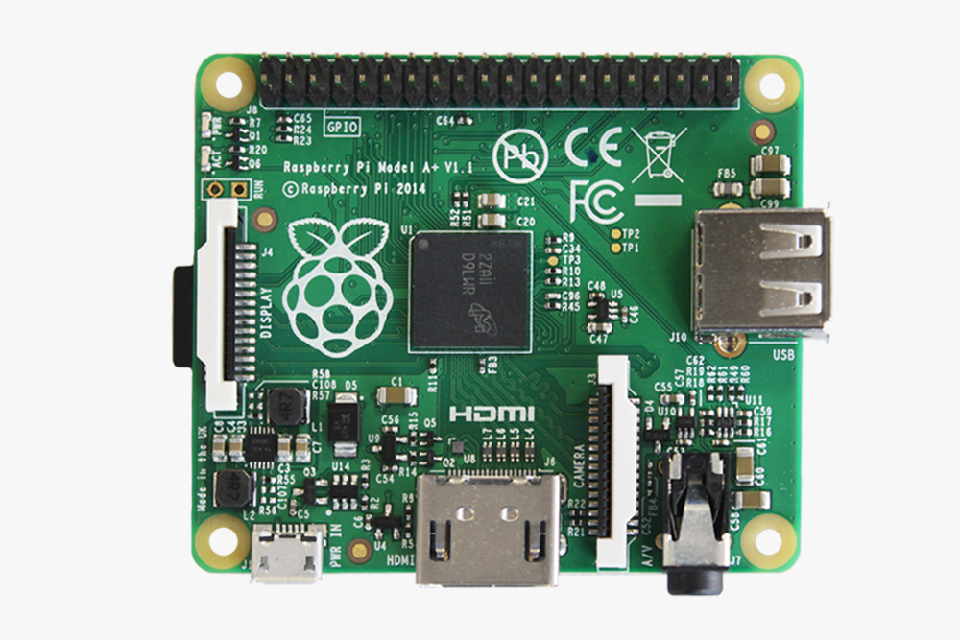
Raspberry Pi Model A+
CPU: BCM2835
No. of cores: 1
Operating Frequency: 700 MHz
GPU: Broadcom VideoCore® IV @250Mhz
RAM: 265MB(shared)
Video out: HDMI + 3.5mm TRRS jack.
Storage: Micro SD
GPIO: 17 Pins
Power: 200mA
Copyright Robosapiens Technology Pvt. Ltd.

Slide 6
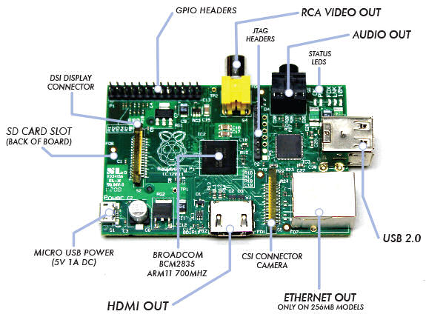
Raspberry Pi Model B
CPU: BCM2835
No. of cores: 1
Operating Frequency: 700 MHz
GPU: Broadcom VideoCore® IV @250Mhz
RAM: 512MB(shared)
Video out: HDMI + RCA
Storage: SD/MMC/SDIO
GPIO: 8 Pins
Power: 700mA
Copyright Robosapiens Technology Pvt. Ltd.

Slide 7
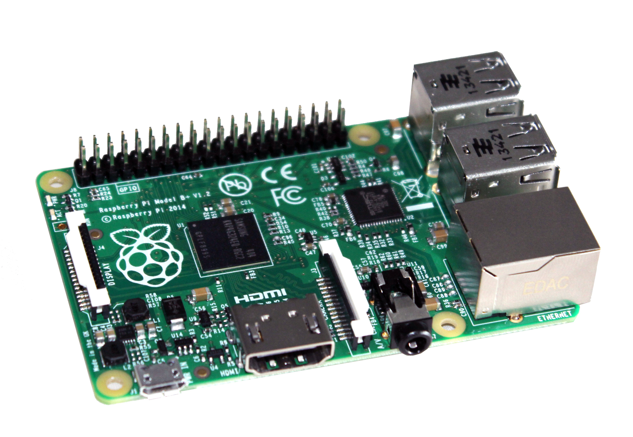
Raspberry Pi Model B+
CPU: BCM2835
No. of cores: 1
Operating Frequency: 700 MHz
GPU: Broadcom VideoCore® IV @250Mhz
RAM: 512MB(shared)
Video out: HDMI + 3.5mm TRRS jack
Storage: Micro SD
GPIO: 17 Pins
Power: 600mA
Copyright Robosapiens Technology Pvt. Ltd.

Slide 8
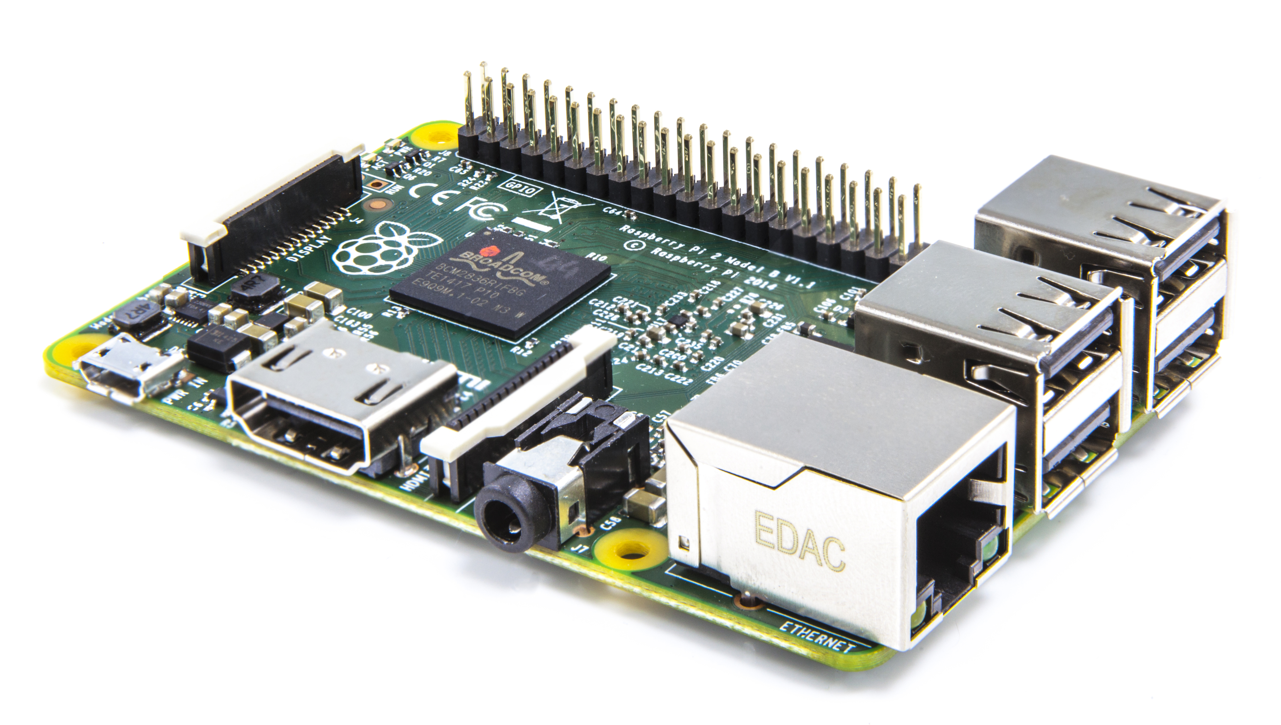
Raspberry Pi 2 Model B
CPU: BCM2836
No. of cores: 4
Operating Frequency: 900 MHz
GPU: Broadcom VideoCore® IV @250Mhz
RAM: 1GB(shared)
Video out: HDMI + 3.5mm TRRS jack
Storage: Micro SD
GPIO: 17 Pins
Power: 800mA
Copyright Robosapiens Technology Pvt. Ltd.

